Slide 1

Lecture 5: Intro to Transfer Learning
AC295
AC295
Advanced Practical Data Science
Pavlos Protopapas

Slide 2
Outline
Communications
Motivation
The Basics idea for Transfer Learning
Formal Definition
Transfer Learning Strategies
Demo: How Transfer Learning Works in Practice

Slide 3
Outline
Communications
Motivation
The Basics idea for Transfer Learning
Formal Definition
Transfer Learning Strategies
Demo: How Transfer Learning Works in Practice

Slide 4
Communications
Practicum submission, please put all your code / memo / video link - within submissions/practicum_<groupname>. Anything other than this directory will not get graded. We will only be pulling that directory.
Practicum submissions pulled right after class (due at 10:15 am today).
Reading question due tomorrow noon (see Ed lessons).
Exercise 4 will be released today.

Slide 5
Outline
Communications
Motivation
The Basics idea for Transfer Learning
Formal Definition
Transfer Learning Strategies
Demo: How Transfer Learning Works in Practice

Slide 6
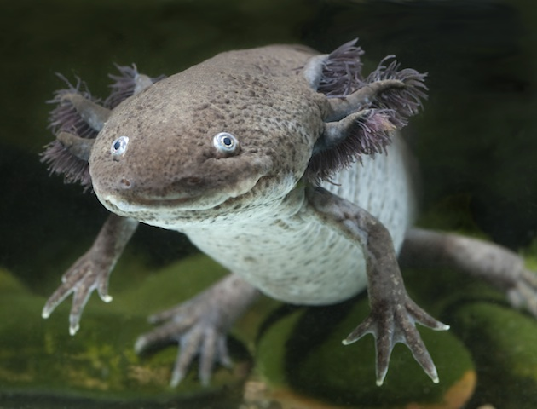
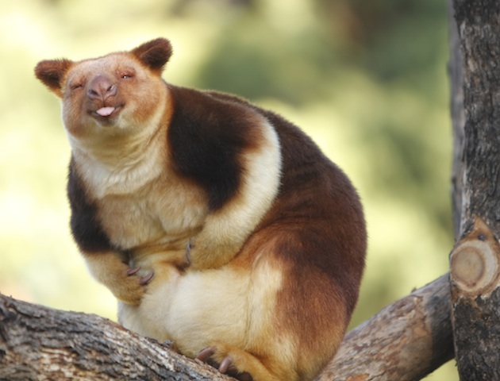
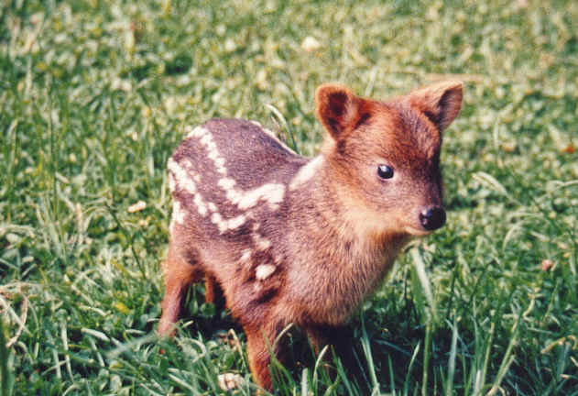
Classify Rarest Animals
Notes:
axolotl mexican, pudu

Slide 7

Classify Rarest Animals
VGG16
Number of parameters: 134,268,737
Data Set: Few hundred images
Notes:
axolotl mexican, pudu

Slide 8
Classify Rarest Animals
VGG16
NOT ENOUGH DATA
Number of parameters: 134,268,737
Data Set: Few hundred images
Notes:
axolotl mexican, pudu

Slide 9
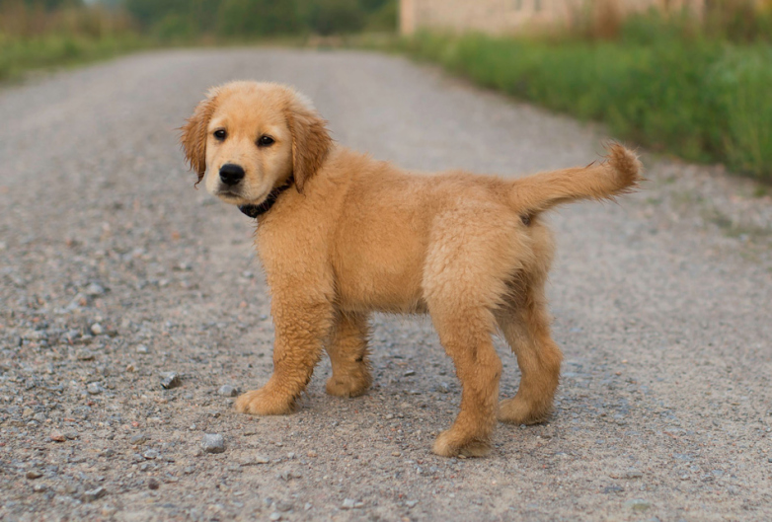
Classify Cats, Dogs, Chinchillas etc
VGG16
Number of parameters: 134,268,737
Enough training data. ImageNet approximate 1.2M

Slide 10
Classify Cats, Dogs, Chinchillas etc
VGG16
TAKES TOO LONG
Number of parameters: 134,268,737
Enough training data. ImageNet approximate 1.2M

Slide 11
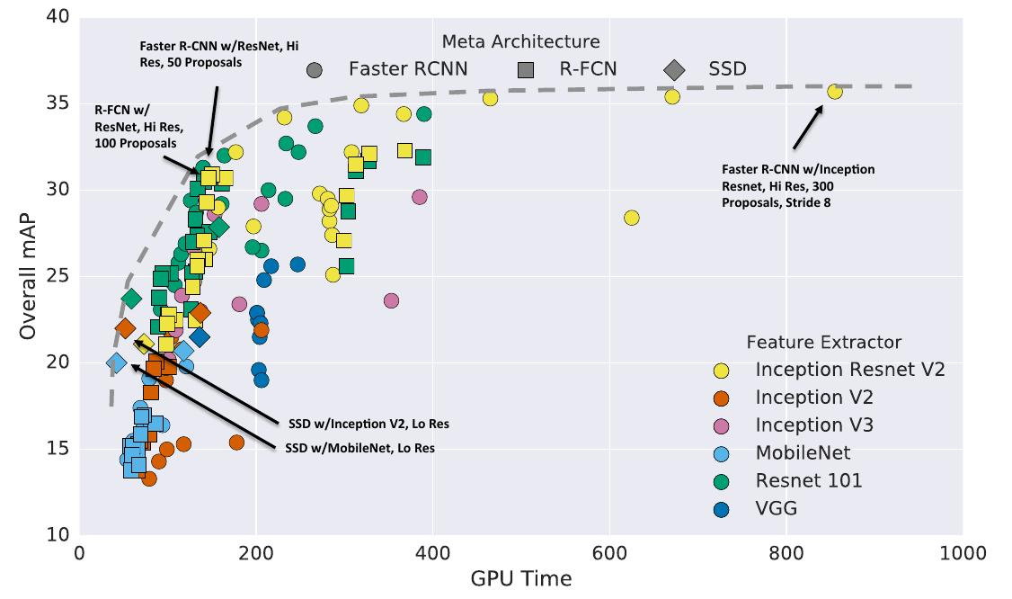

Slide 12

Transfer Learning To The Rescue
How do you build an image classifier that can be trained in a few minutes on a CPU with very little data?

Slide 13
Outline
Communications
Motivation
The Basics idea for Transfer Learning
Formal Definition
Transfer Learning Strategies
Demo: How Transfer Learning Works in Practice

Slide 14
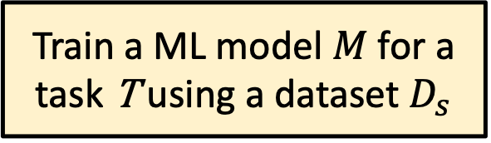
Basic idea of Transfer Learning
Train a ML model $M$ for a task T using a dataset $D_{s}$

Slide 15
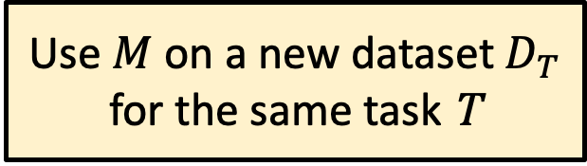
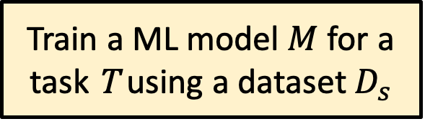
Basic idea of Transfer Learning
Train a ML model $M$ for a task T using a dataset $D_{s}$
Use $M$ on a new dataset $D_{T}$ for the same task T

Slide 16
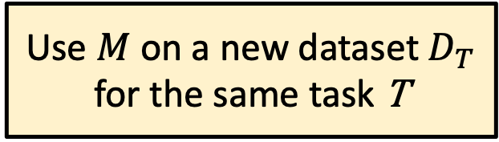
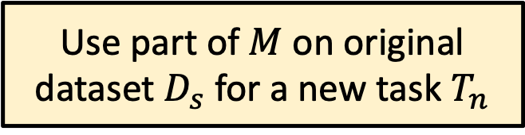
Basic idea of Transfer Learning
Train a ML model $M$ for a task T using a dataset $D_{s}$
Use $M$ on a new dataset $D_{T}$ for the same task T
Use part of $M$ on original dataset $D_{s}$ for a new task $T_{n}$

Slide 17
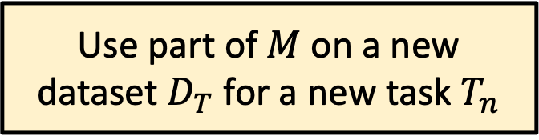
Basic idea of Transfer Learning
Train a ML model $M$ for a task T using a dataset $D_{s}$
Use $M$ on a new dataset $D_{T}$ for the same task T
Use part of $M$ on original dataset $D_{s}$ for a new task $T_{n}$
Use part of $M$ on a new dataset $D_{T}$ for a new task $T_{n}$

Slide 18
Basic idea of Transfer Learning
Train a ML model $M$ for a task T using a dataset $D_{s}$
Wikipedia:
Transfer learning (TL) is a research problem in machine learning (ML) that focuses on storing knowledge gained while solving one problem and applying it to a different but related problem.^{[1]}
Use $M$ on a new dataset $D_{T}$ for the same task T
Use part of $M$ on original dataset $D_{s}$ for a new task $T_{n}$
Use part of $M$ on a new dataset $D_{T}$ for a new task $T_{n}$

Slide 19
Basic idea of Transfer Learning (cont)
How do you make an image classifier that can be trained in a few minutes on a CPU with very little data?

Slide 20
Basic idea of Transfer Learning (cont)
How do you make an image classifier that can be trained in a few minutes on a CPU with very little data?
Use pre-trained models, i.e., models with known weights.

Slide 21
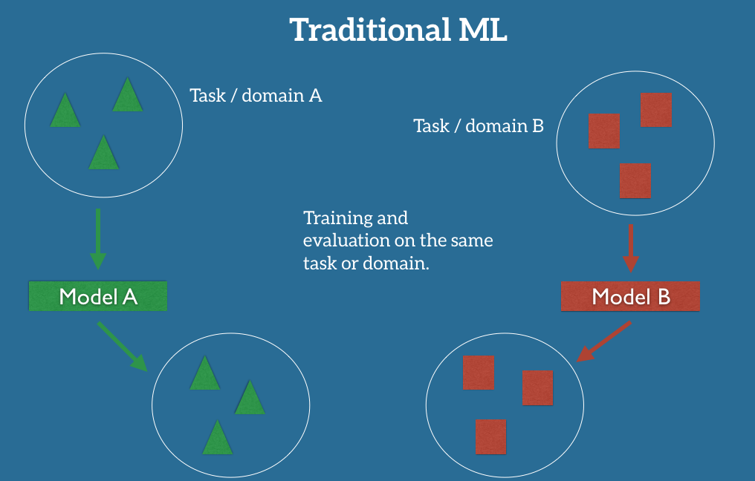
Basic idea of Transfer Learning (cont.)

Slide 22
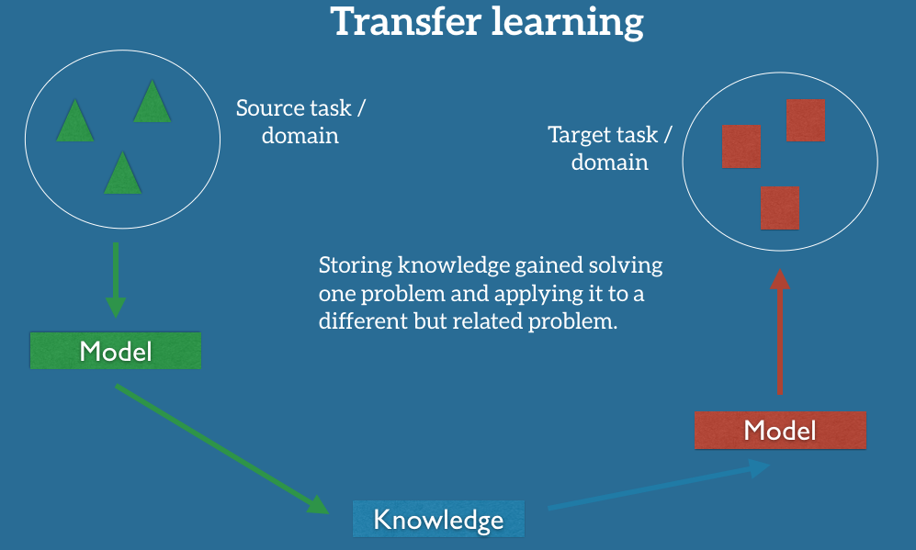
Basic idea of Transfer Learning (cont.)

Slide 23
Basic idea of Transfer Learning (cont)
How do you make an image classifier that can be trained in a few minutes on a CPU with very little data?
Use pre-trained models, i.e., models with known weights.
Main Idea: Earlier layers of a network learn low level features, which can be adapted to new domains by changing weights at later and fully-connected layers.
Example: Use ImageNet trained with any sophisticated huge network. Then retrain it on a few images.

Slide 24
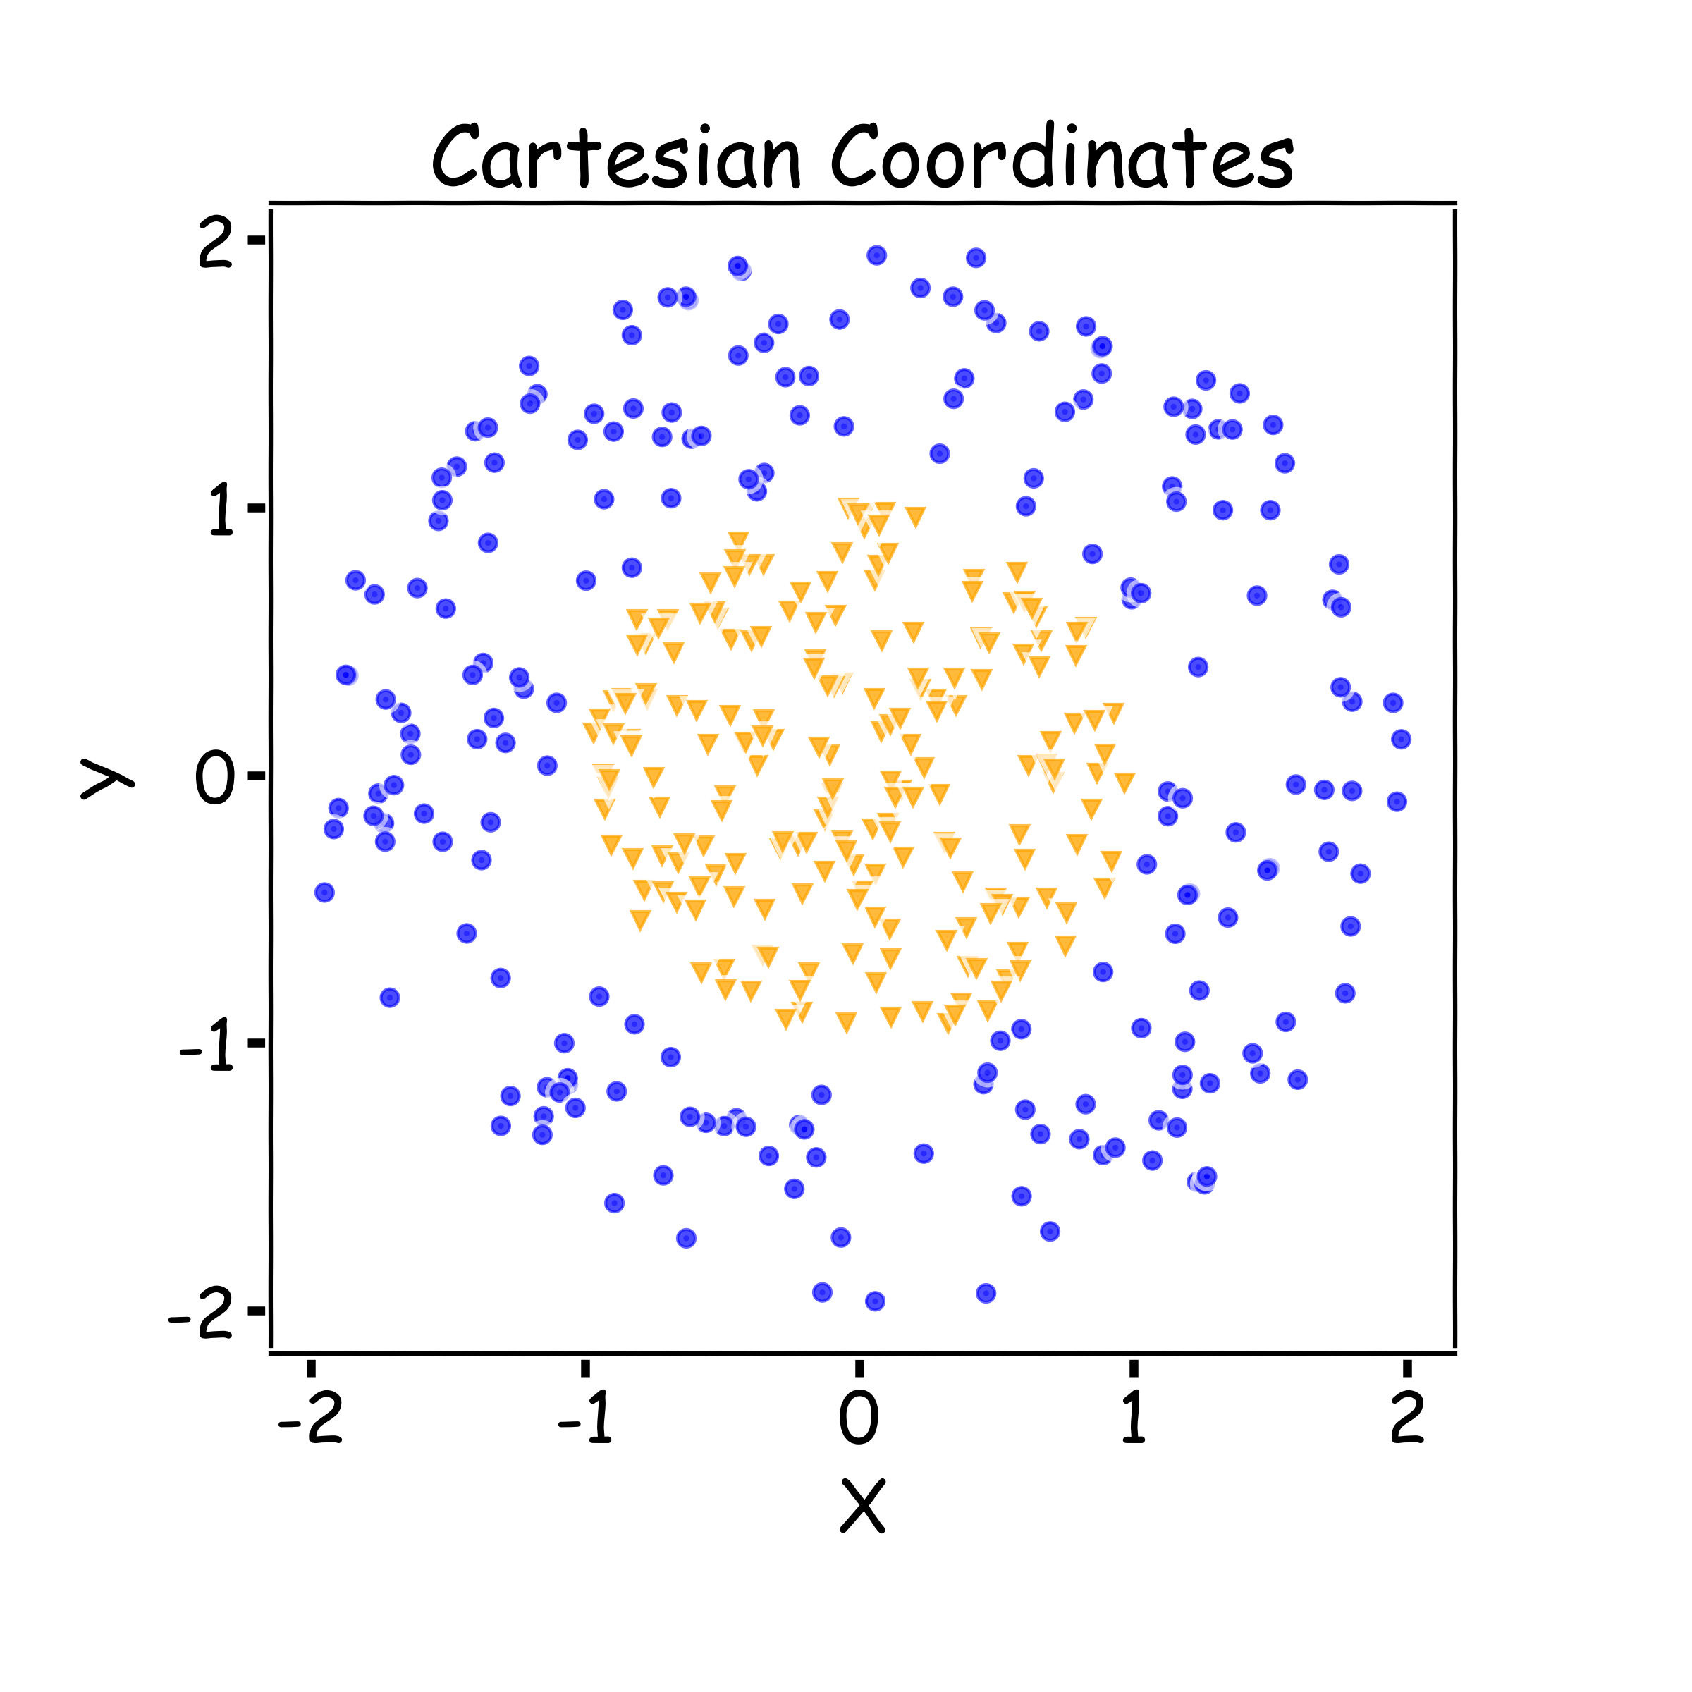
Key Idea: Representation Learning
Relatively difficult task

Slide 25
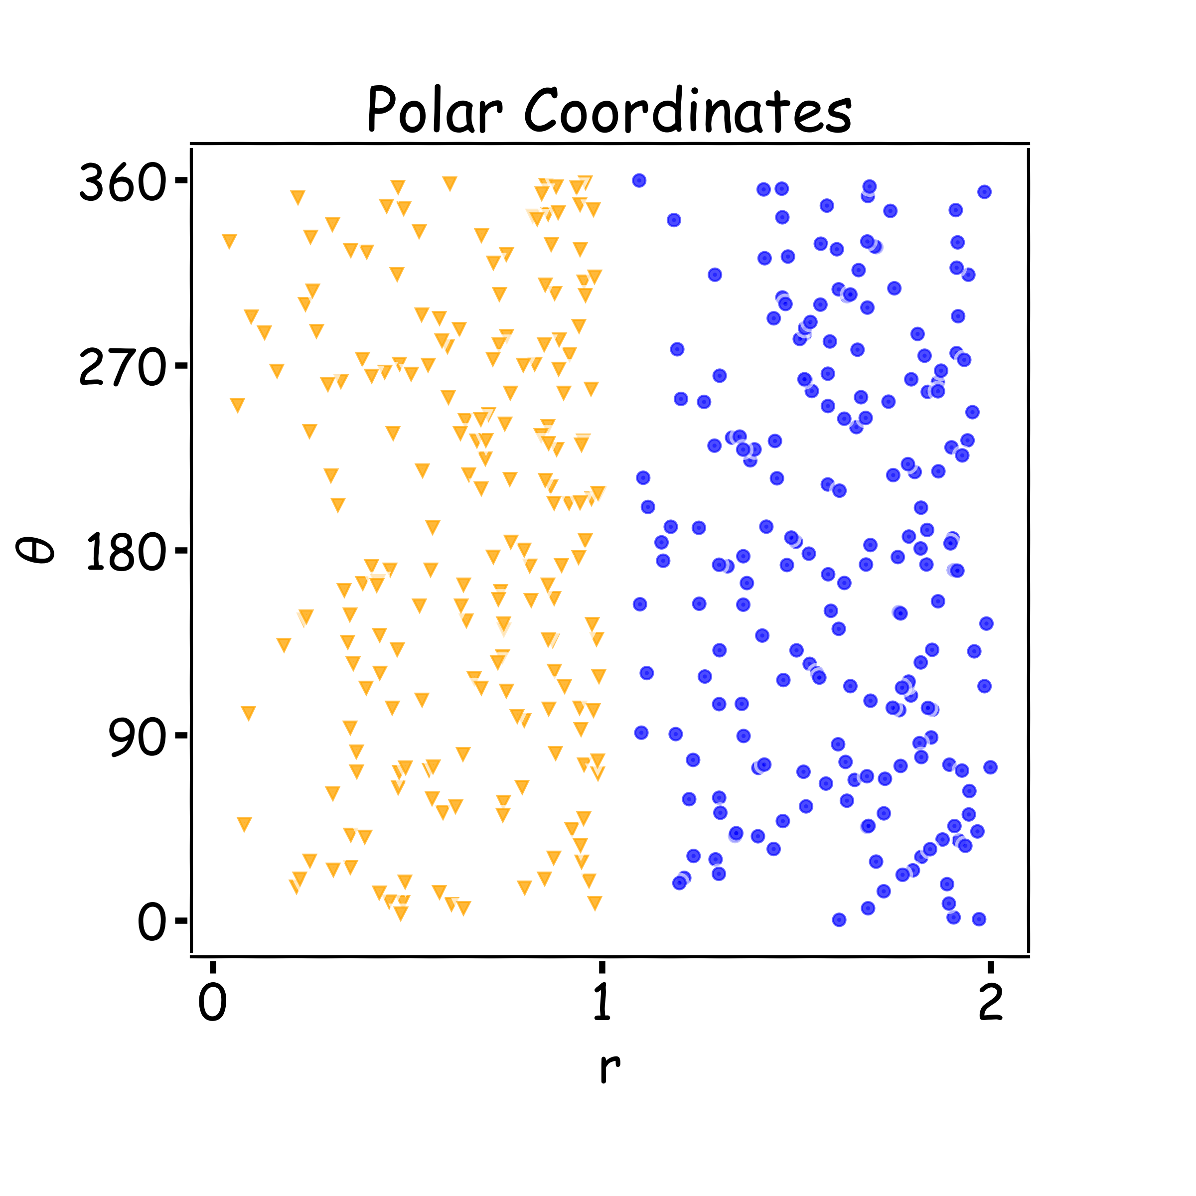
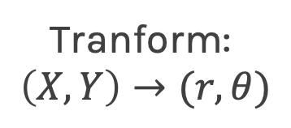
Key Idea: Representation Learning
Relatively difficult task
Easier task
Tranform:
$$\left(X,Y\right)→(r,θ)$$

Slide 26

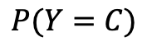
Representation Learning
Task: classify cars, people, animals and objects
FCN
CNN Layer 1
CNN Layer 2
CNN Layer n
…
$$P(Y=C)$$

Slide 27
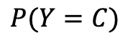
Representation Learning
Task: classify cars, people, animals and objects
FCN
CNN Layer 1
CNN Layer 2
CNN Layer n
…
$$P(Y=C)$$

Slide 28
Basic idea of Transfer Learning (cont)
Train on a big "source" data set, with a big model, on one downstream tasks (say classification). Do it once and save the parameters. This is called a pre-trained model.
Use these parameters for other smaller "target " datasets, say, for classification on new images (possibly different domain, or training distribution), or for image segmentation on old images (new task), or new images (new task and new domain).

Slide 29
Basic idea of Transfer Learning (cont)
Train on a big "source" data set, with a big model, on one downstream tasks (say classification). Do it once and save the parameters. This is called a pre-trained model.
Use these parameters for other smaller "target " datasets, say, for classification on new images (possibly different domain, or training distribution), or for image segmentation on old images (new task), or new images (new task and new domain).
Less helpful if you have a large target dataset with many labels.
Will fail if source domain (where you trained big model) has nothing in common with target domain (that you want to train on smaller data set).

Slide 30
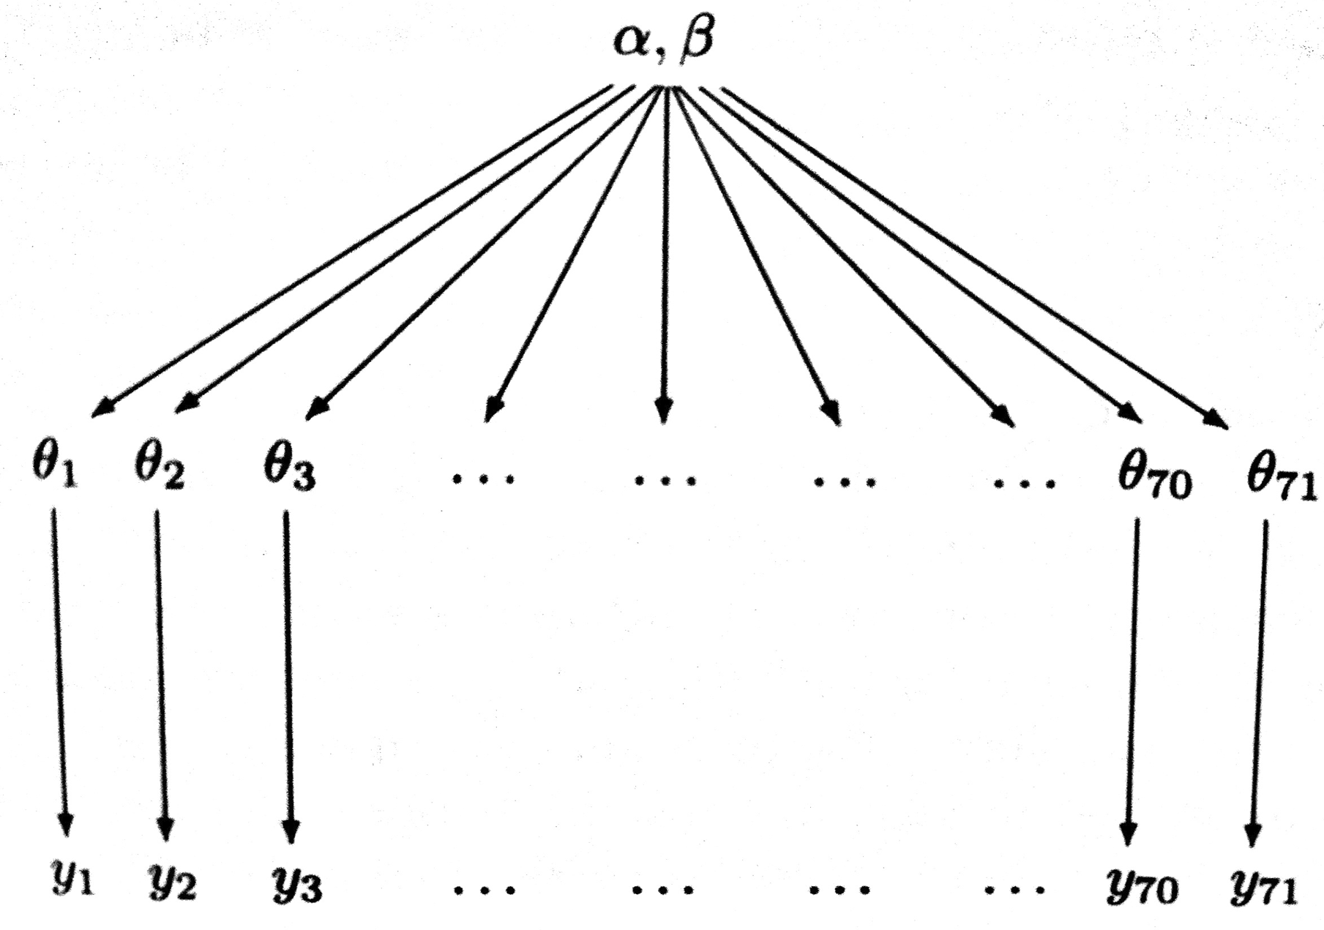
Transfer Learning
Not a new idea!
It has been there in the ML and stats literature for a while.
• An exemplar is hierarchical glm models in stats, where information flows from higher data units to lower data units to the lower data.
• Neural networks learn hierarchical representations and thus are particularly suited to this kind of learning. Furthermore, since we learn representations, we can deal with domain adaptation/covariate shift.

Slide 31
Applications of Transfer Learning
• Learn from simulations (self-driving cars)
• Domain adaptation: bikes -> bikes with backgrounds, bikes at night, etc
• Speech recognition for immigrants and minorities
• Cross-lingual adaptation for few shot learning of resource-poor languages (English->Nepalis, for example)

Slide 32
Applications of Transfer Learning
• Create a classifier to distinguish dogs and cats.
• Use a convnet previously trained (expensive to learn)
• e.g. Imagenet (1.4 M images and 1000 classes).
• In NLP, you might use a language model trained on Wikipedia and reddit, and then look at legal documents.

Slide 33
Outline
Communications
Motivation
The Basics idea for Transfer Learning
Formal Definition
Transfer Learning Strategies
Demo: How Transfer Learning Works in Practice

Slide 34
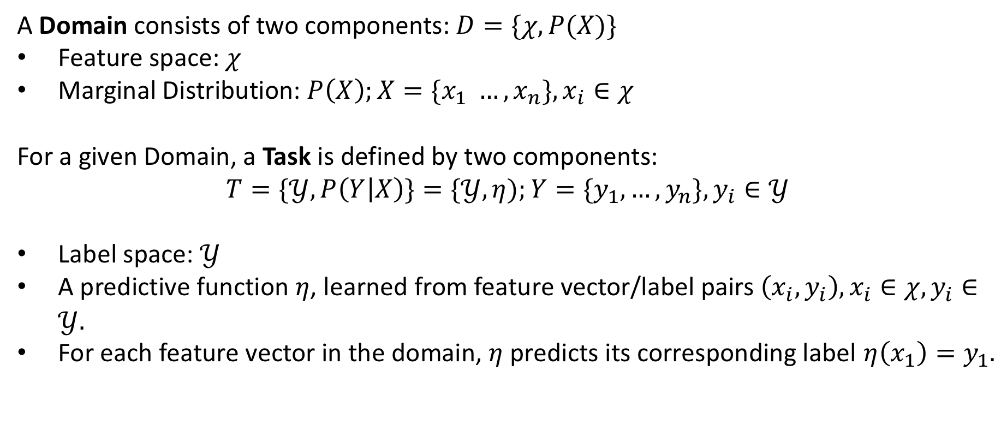
A Formal Definition
A Domain consists of two components: $D=\{χ, P(X)\}$
Feature space: $χ$
Marginal Distribution: $P\left(X\right);X=\{x_{1} …, x_{n}\}, x_{i}∈χ$
For a given Domain, a Task is defined by two components:
$$T=\{𝒴, P\left(Y | X\right)\}=\{𝒴, η);Y=\{y_{1},…, y_{n}\}, y_{i}∈𝒴$$
Label space: $𝒴$
A predictive function $η$, learned from feature vector/label pairs $\left(x_{i},y_{i}\right), x_{i}∈χ, y_{i}∈𝒴.$
For each feature vector in the domain, $η$ predicts its corresponding label $η\left(x_{1}\right)=y_{1}.$
Pan and Yang, A Survey on Transfer Learning

Slide 35
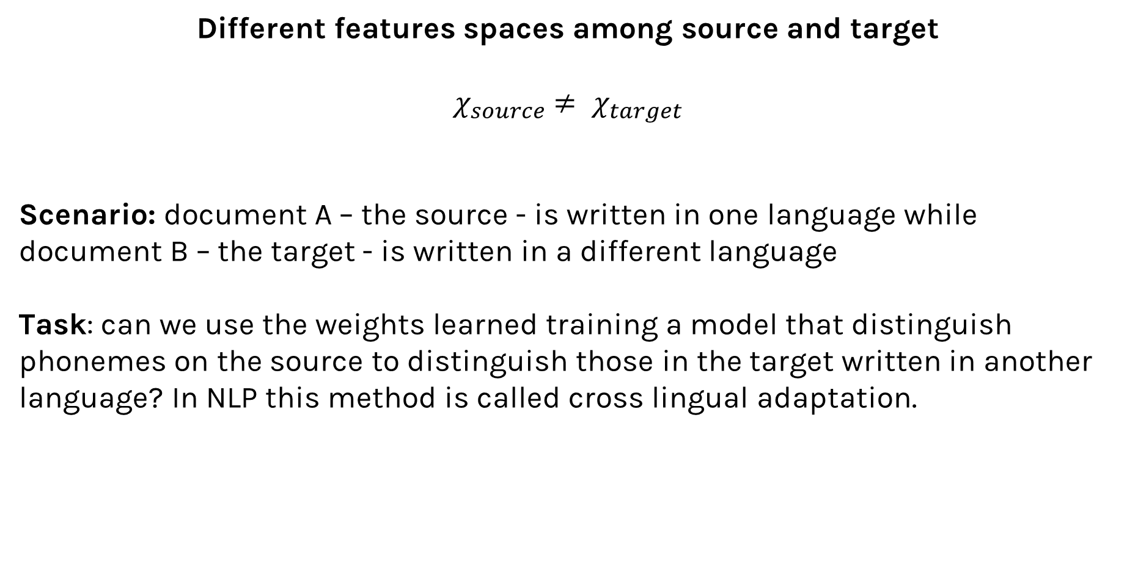
Scenarios
Different features spaces among source and target
$χ_{source}$ $≠ χ_{target}$
Scenario: document A – the source - is written in one language while document B – the target - is written in a different language
Task: can we use the weights learned training a model that distinguish phonemes on the source to distinguish those in the target written in another language? In NLP this method is called cross lingual adaptation.

Slide 36
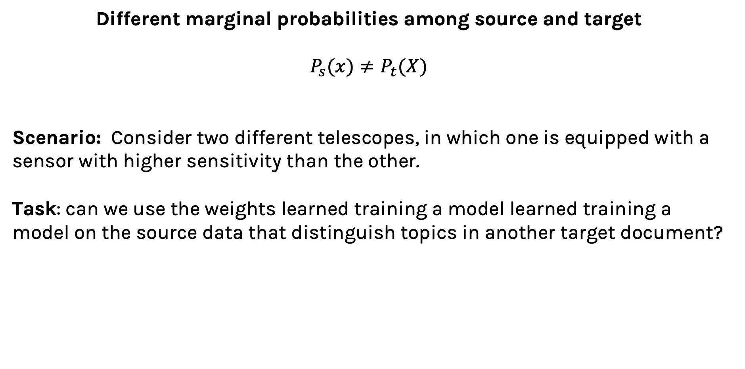
Scenarios
Different marginal probabilities among source and target
$P_{s}(x)≠P_{t}(X)$
Scenario: Consider two different telescopes, in which one is equipped with a sensor with higher sensitivity than the other.
Task: can we use the weights learned training a model learned training a model on the source data that distinguish topics in another target document?

Slide 37
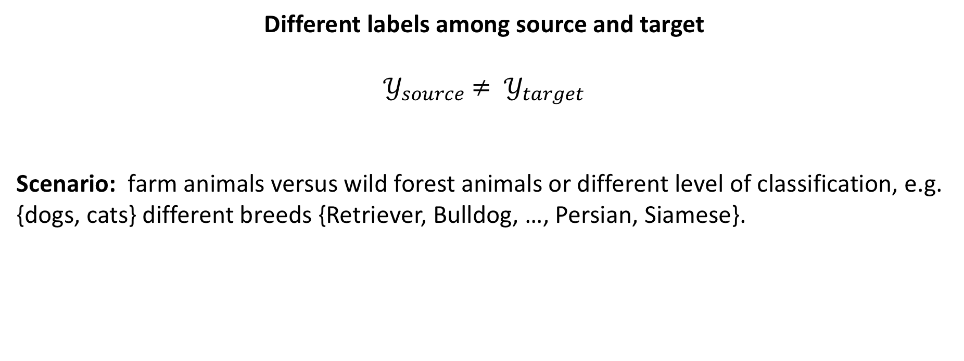
Scenarios
Different labels among source and target
$𝒴_{source}$ $≠ 𝒴_{target}$
Scenario: farm animals versus wild forest animals or different level of classification, e.g. {dogs, cats} different breeds {Retriever, Bulldog, …, Persian, Siamese}.

Slide 38
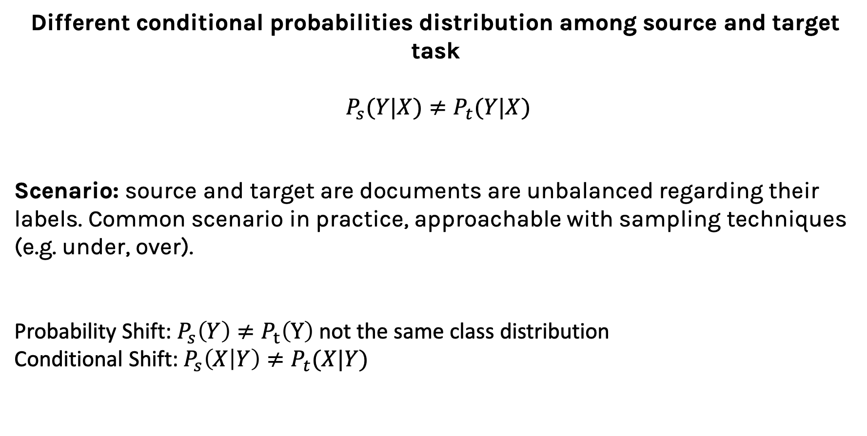
Scenarios
Different conditional probabilities distribution among source and target task
$P_{s}(Y|X)≠P_{t}(Y|X)$
Scenario: source and target are documents are unbalanced regarding their labels. Common scenario in practice, approachable with sampling techniques (e.g. under, over).
Probability Shift: $P_{s}\left(Y\right)≠P_{t}\left(Y\right)$ not the same class distribution
Conditional Shift: $P_{s}\left(X | Y\right)≠P_{t}(X|Y)$

Slide 39
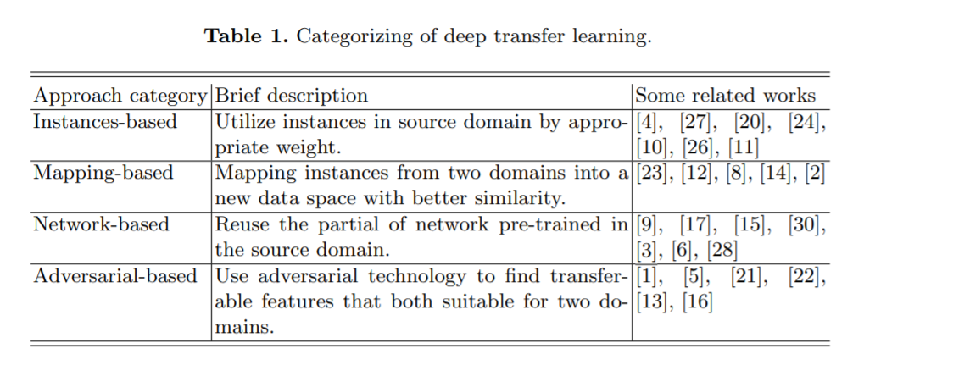
Categories

Slide 40
Key Takeaways
During the process of transfer learning, the following three important questions must be answered:
What to transfer? Identify which portion of knowledge is source-specific and what is common between the source and the target.
When to transfer? Aim at utilizing transfer learning to improve target task performance/results and not degrade them. We need to be careful about when to transfer and when not to.
How to transfer? Changes to existing algorithms and different techniques, which we will cover in later sections of this article.

Slide 41
Transfer Learning Strategies
There are different transfer learning strategies and techniques, which can be applied based on the domain, task at hand, and the availability of data:
Inductive Transfer learning: the source and target have same domains, yet the they have different tasks. The algorithms utilize the inductive biases of the source domain to help improve the target task.
Unsupervised Transfer Learning: the source and target have same domains, with a focus on unsupervised tasks in the target domain. The source and target domains are similar, but the tasks are different. In this scenario, labeled data is unavailable in either of the domains.
Transductive Transfer Learning: In this scenario, there are similarities between the source and target tasks, but the corresponding domains are different. In this setting, the source domain has a lot of labeled data, while the target domain has none.

Slide 42
Transfer Learning Strategies
The approaches for Transfer Learning can be defined in few categories:
Instance transfer: Reusing knowledge from the source domain to the target task (ideal scenario). In most cases, the source domain data cannot be reused directly.
Feature-representation transfer: This approach aims to minimize domain divergence and reduce error rates by identifying good feature representations that can be utilized from the source to target domains.
Parameter transfer: This approach works on the assumption that the models for related tasks share some parameters or prior distribution of hyperparameters.
Relational-knowledge transfer attempts to handle non-IID data, such as data that is not independent and identically distributed.

Slide 43
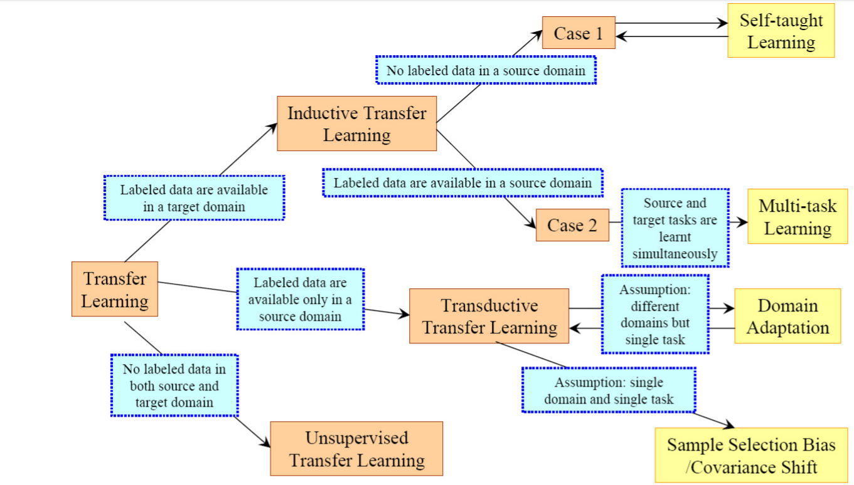
Transfer Learning Strategies
Pan and Yang, A Survey on Transfer Learning

Slide 44
Outline
Communications
Motivation
The Basics idea for Transfer Learning
Formal Definition
Transfer Learning Strategies
Demo: How Transfer Learning Works in Practice

Slide 45
Transfer Learning for Deep Learning
What people think
you can’t do deep learning unless you have a million labeled examples.
What people can do, instead
You can learn representations from unlabeled data
You can train on a nearby objective for which is easy to generate labels (imageNet).
You can transfer learned representations from a relate task.

Slide 46
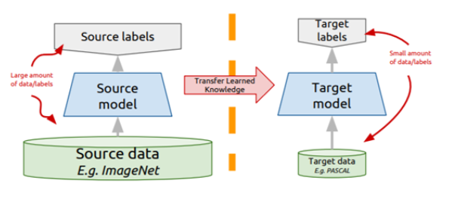
Transfer Learning for Deep Learning
Instead of training a network from scratch:
Take a network trained on a different domain for a different source task
Adapt it for your domain and your target task
Variations
Same domain, different task.
Different domain, same task.

Slide 47

Extremely short review of CNN

Slide 48
Example
Let C be a CNN with the following disposition:
Input: 32x32x3 images
Conv1: 8 3x3 filters, stride 1, padding=same
Conv2: 16 5x5 filters, stride 2, padding=same
Flatten layer
Dense1: 512 nodes
Dense2: 4 nodes
How many parameters does this network have?
(8 x 3 x 3 x 3 + 8) + (16 x 5 x 5 x 8 + 16) + (16 x 16 x 16 x 512 + 512) + (512 x 4 + 4)
Conv1
Conv2
Dense1
Dense2
Notes:
NEEDS A FIGURE

Slide 49
Input
(size=32X32,
channels=3)
Filter
8 x (size=3X3x3,
stride = 1,
padding = same)
Output
(size=32X32,
channels = 8)
filter x 1
How many parameters does the layer have if I want to use 8 filters?
n_filters x filter_volume + biases = total number of params
8 x (3 x 3 x 3) + 8 = 224

Slide 50
Input
(size=32X32,
channels=8)
Filter
16 x (size=5X5X8,
stride = 2,
padding = same)
Output
(size=16X16,
channels=16)
16 filters
How many parameters does the layer have if I want to use 16 filters?
n_filters x filter_volume + biases = total number of params
16 x (5 x 5 x 8) + 16 = 3216

Slide 51
Input
(size=16X16,
channels=16)
Flatten
(size= 16X16X16)
Fully Connected
(n_nodes=512)
Fully Connected
(n_nodes=4)
How many parameters … ?
input x FC1_nodes + FC2_nodes = total number of params
(16x16x16) x 512 + 512 + 512 x 4 + 4 = 2,099,716

Slide 52
Outline
Communications
Motivation
The Basics idea for Transfer Learning
Formal Definition
Transfer Learning Strategies
Demo: How Transfer Learning Works in Practice

Slide 53
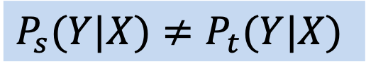
Representation Extraction
Prediction
Use representations learned by big net to extract features from new samples, which are then fed to a new classifier:
• Keep (frozen) convolutional base from big model.
• Generally throw away head FC layers since these have no notion of space, and convolutional base is more generic.
• Since there are both dogs and cats in ImageNet you could get away with using the head FC layers as well. But by throwing it away you can learn more from other dog/cat images.
Head
randomly initialize
Base Trained CNN
FREEZE
Input
$$P_{s}(Y|X)≠P_{t}(Y|X)$$

Slide 54
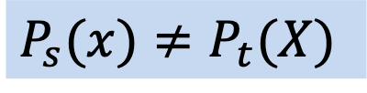
Fine-tuning
Prediction
• Up to now we have frozen the entire convolutional base.
• Remember that earlier layers learn highly generic feature maps (edges, colors, textures).
• Later layers learn abstract concepts (dog’s ear).
• To particularize the model to our task, its often worth tuning the later layers as well.
• But we must be very careful not to have big gradient updates.
Head
randomly initialize
Fine tune some layers
Base Trained CNN
FREEZE
$P_{s}(x)≠P_{t}(X)$
Input

Slide 55
Procedure for Fine-tuning
Freeze the convolutional base.
First train the fully connected head you added, keeping the convolutional base fixed.
Unfreeze some "later" layers in the base net and now train the base net and FC net together.
Since you are now in a better part of the loss surface already, gradients won't be terribly high, but we still need to be careful. Thus often we use a very low learning rate.

Slide 56
Transfer Learning for Deep Learning: Differential Learning Rates
Prediction
• A low learning rate can take a lot of time to train on the "later" layers. Since we trained the FC head earlier, we could probably retrain them at a higher learning rate.
• General Idea: Train different layers at different rates.
• Each "earlier" layer or layer group (the color-coded layers in the image) can be trained at 3x-10x smaller learning rate than the next "later" one.
• One could even train the entire network again this way until we overfit and then step back some epochs.
Dense Layer
Largest optimal learning rate
Dense Layer
Dense Layer
Conv Layer
Relatively larger learning rate
Conv Layer
Conv Layer
Conv Layer
Smaller learning rate
Conv Layer
Conv Layer
Input

Slide 57
Outline
Communications
Motivation
The Basics idea for Transfer Learning
Formal Definition
Transfer Learning Strategies
Demo: How Transfer Learning Works in Practice
TF Classification

Slide 58
THANK YOU
AC295
Advanced Practical Data Science
Pavlos Protopapas

